Slide 1

SOCIAL MEDIA DASHBOARD
Team Details: Ritin Chauhan(2310990867)
Riya Saini(2310990868)
Rohan Maddhesiya(2310990869)
Faculty Coordinator: Dr. Mohammad Shuaib Khan
Chitkara University Institute of Engineering and Technology,
Chitkara University, Punjab

Slide 2


Table of Contents
Introduction
Problem Statement
Technical Details
Key Features
Project Highlights
Bonus Feature(optional)
Conclusion
References/Links used

Slide 3
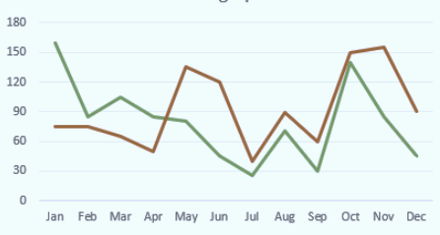
Introduction
About the Project:
The project of this semester is the SOCIAL MEDIA DASHBOARD. A social media dashboard display all of the key parts of social media campaign in one place and provides quick insights into how well your social media strategies are working.
Objective of Project:
Using a social media dashboard, we can observe which social media methods are most effective for us and our company, as well as which ones aren’t. We need social media dashboard for the same reason we do need any other specialized software in our business: it will help us stay organized, increase output, assist us in our work, have better knowledge of our performance, and enhance it.

Slide 4





TOOL USED:
For making of this website we use Website-Building Platform that is:
HYPERTEXT MARKUP LANGUAGE (HTML)
CASCADING STYLE SHEET (CSS)
JAVASCRIPT (JS)
TEAM MEMBERS:
Ritin Chauhan
Riya Saini
Rohan Maddhesiya

Slide 5





Problem Statement
In the digital age, the use of social media is pervasive, with billions of individuals and businesses actively engaging on platforms such as Facebook, twitter, Instagram, and linkedin. However, managing multiple social media accounts efficiently and making data-driven decision can be challenging. To address these issues, our project aims to develop a comprehensive Social Media Dashboard using HTML and CSS.

Slide 6
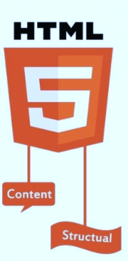
Technical Details
Technologies use in formation of this project are:
HTML- Hypertext Markup Language
CSS- Cascading Style Sheet
Photoshop
JAVASCRIPT
Explanation of the Technologies used:
HTML: It is the standard markup language for documents to be displayed in a web browser. It defines the meaning and structure of web content. It allows the creation and structure of sections, paragraphs, and links using HTML elements such as tags and attributes.

Slide 7
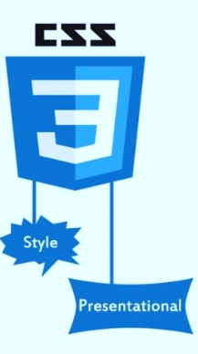

CSS: It is a style sheet language which is used to describe the look and formatting of a document written in markup language. It provides an additional feature to HTML. It is generally used with HTML to change the style of web pages and user interfaces.
PHOTOSHOP: photoshop is a photo-editing software. It is a popular image changing software package. It is a tool for designers, web developers, graphic artists, photographers, and creative professionals.

Slide 8

JAVASCRIPT: JavaScript is the dominant client-side scripting language of the web. Scripts are embedded in or included from HTML documents and interact with thee DOM(Document Object Mode). It allows developers to create dynamically updating content, use animations, pop-up menus, clickable buttons, control multimedia, etc.

Slide 9
Key Features
Key features of a social dashboard include a single-view display of metrics, easy sharing with team members, and customizable visualizations based on the target audience’s needs.
Top metrics include the track of followers, reach, likes, comments, shares, post clicks, average video watch time, and mentions.
Features of social media dashboard:
Real-time monitoring: using a social media dashboard with real-time monitoring features, you can keep track of your accounts and respond to comments or messages as soon as they appear.
Analytical and reporting: A social media dashboard with analytics and reporting capabilities can assist you in tracking the performance of your social media accounts.
Ease of use: A well-organized social media dashboard will assist in navigating the platform more swiftly and efficiently, completing task. Dashboard with an intuitive layout will help you manage your social media account more effectively

Slide 10
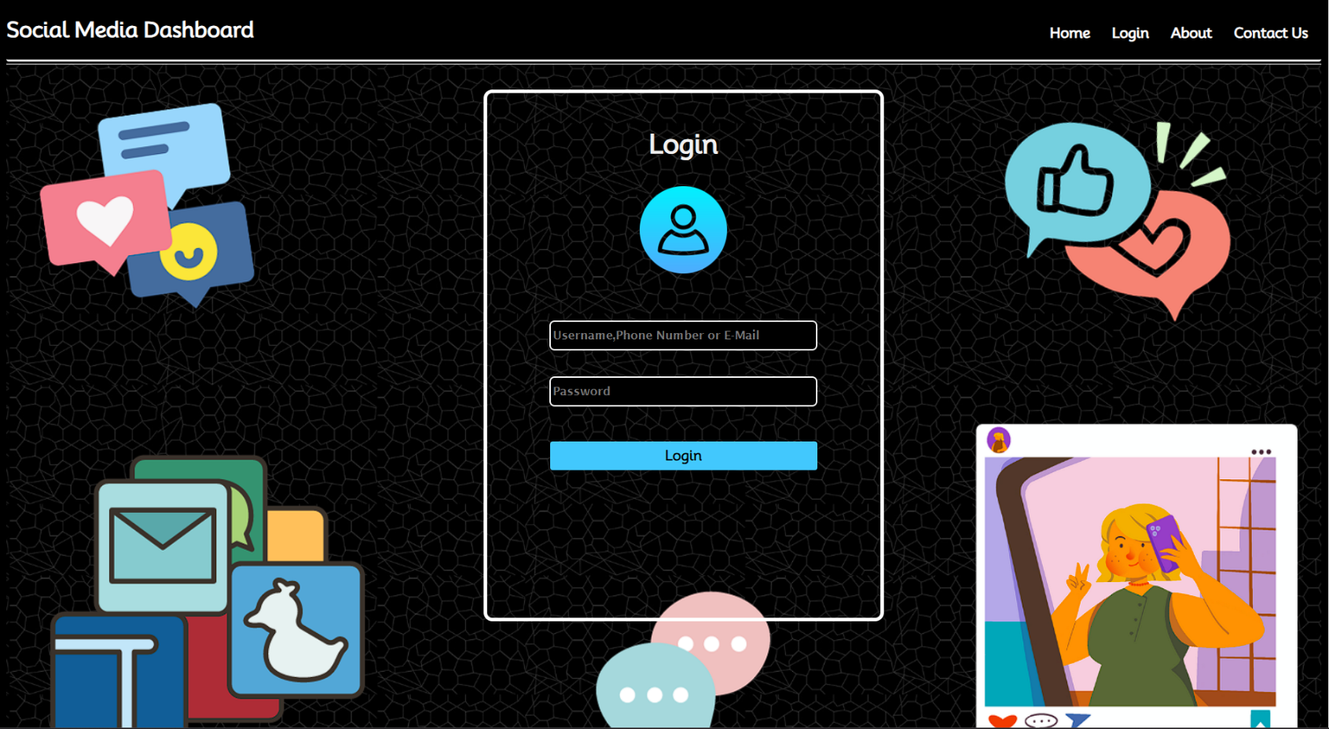
Project Highlights
Login Page

Slide 11
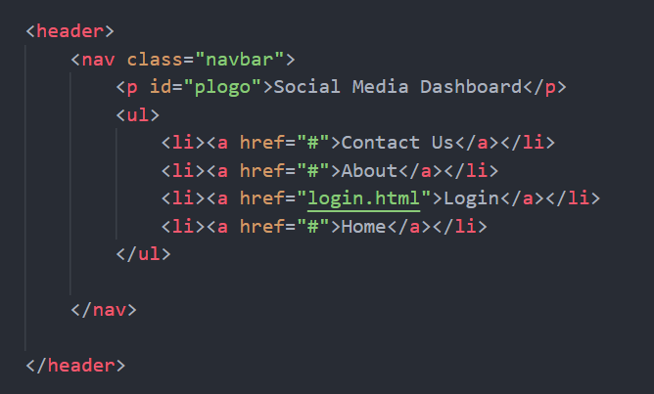
Navbar
Code
1.HTML

Slide 12
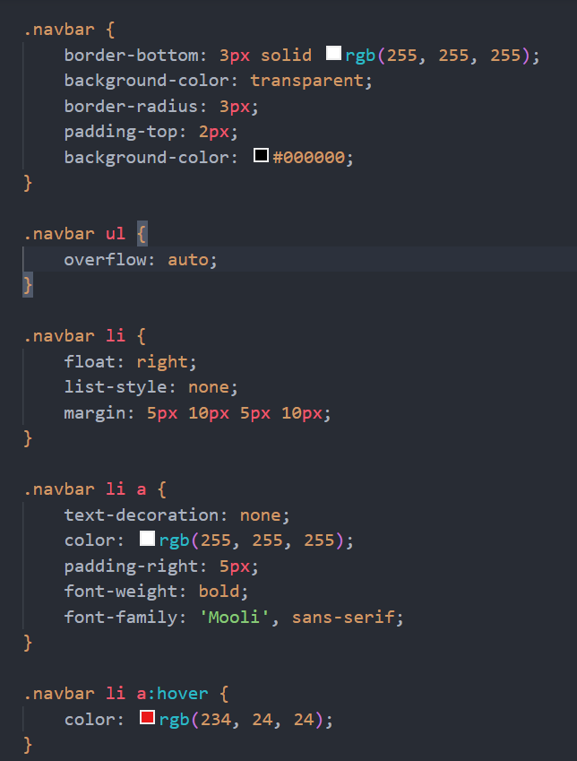
2. CSS

Slide 13
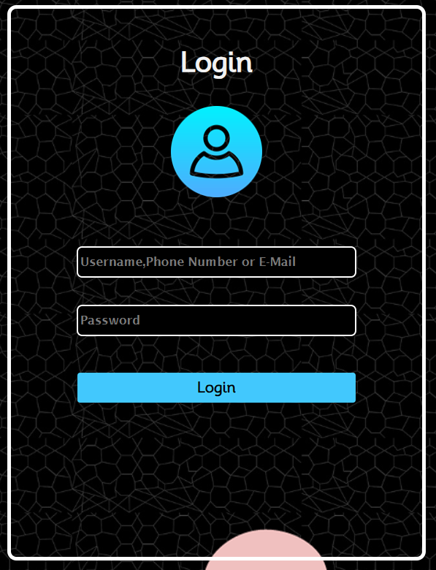
Login Container

Slide 14
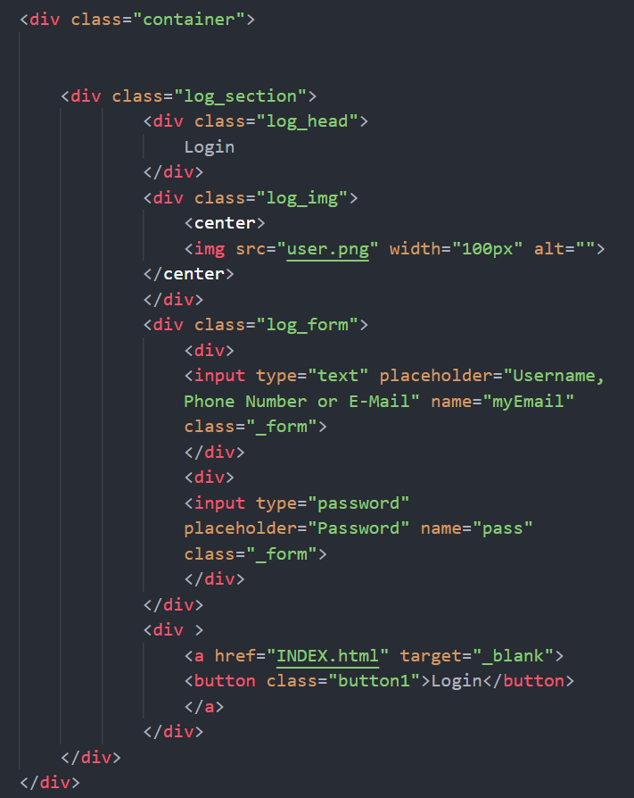
Code
1. HTML

Slide 15
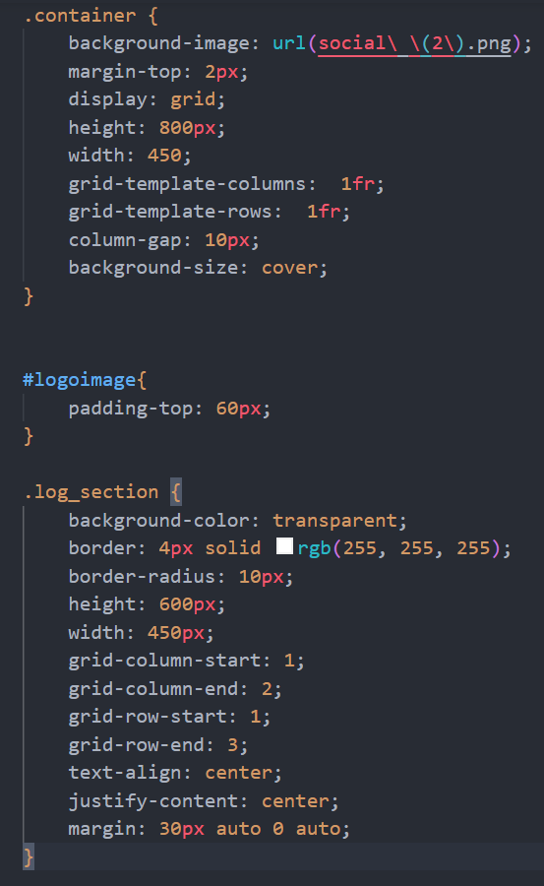
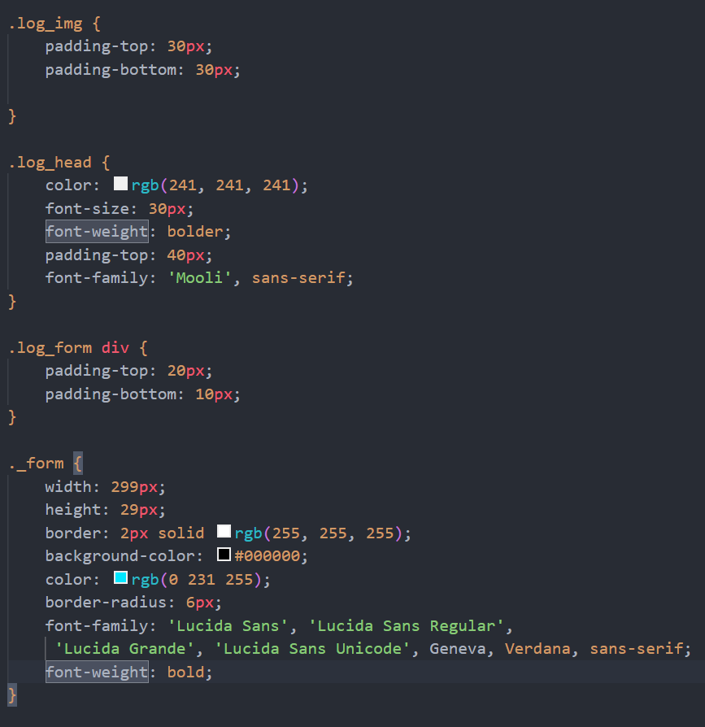
2. CSS

Slide 16
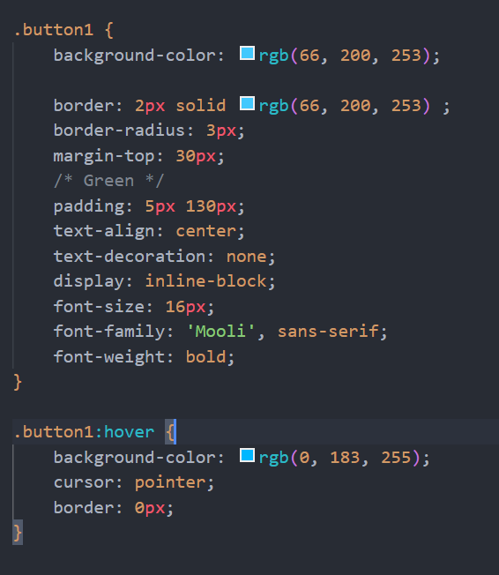

Slide 17
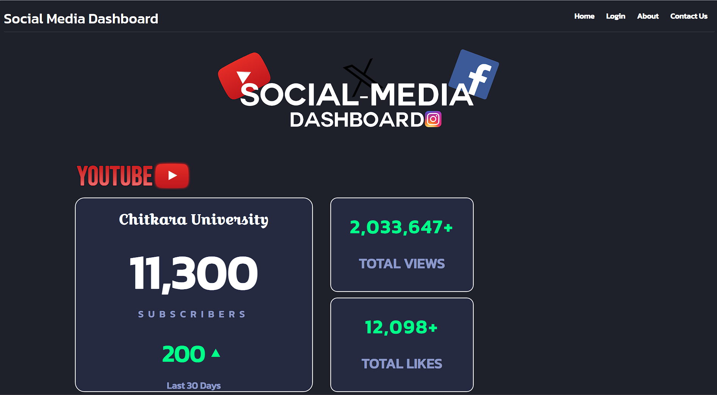
Main Webpage

Slide 18
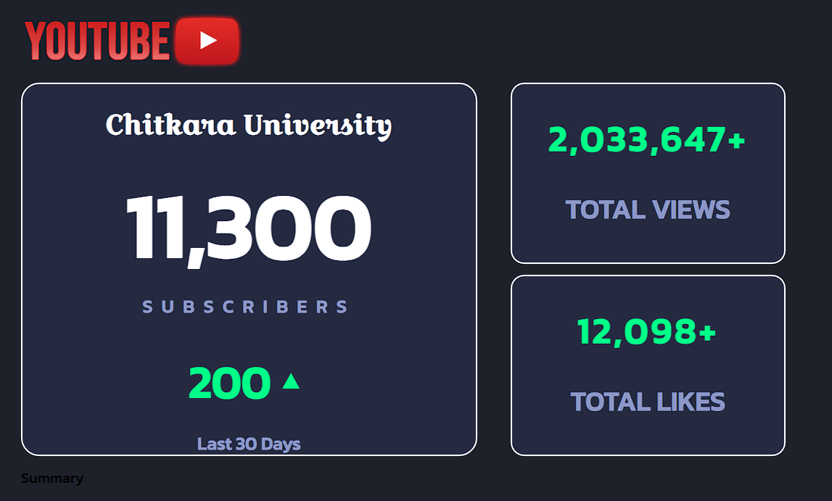
YouTube

Slide 19
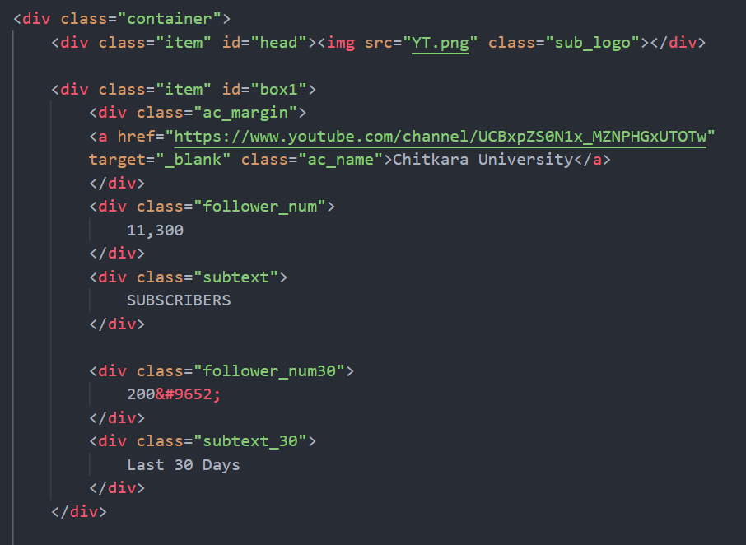
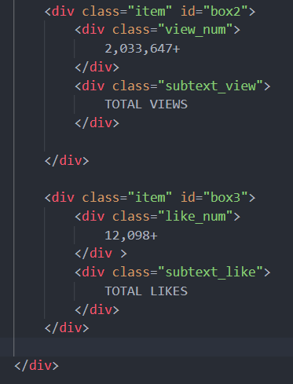
Code
1.HTML

Slide 20
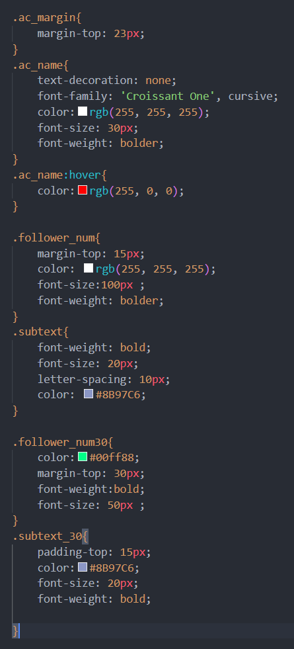
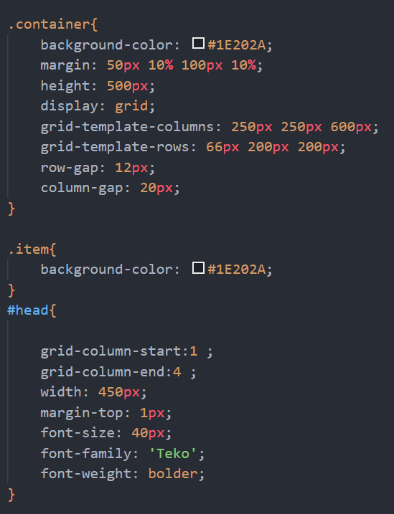
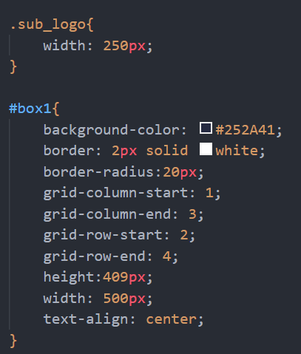
2. CSS

Slide 21
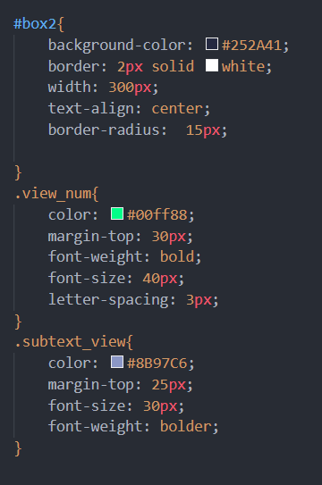
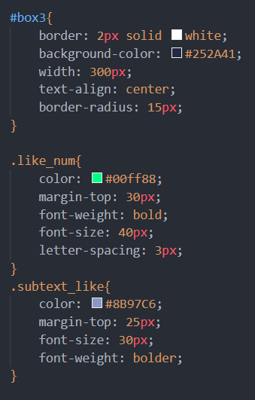

Slide 22
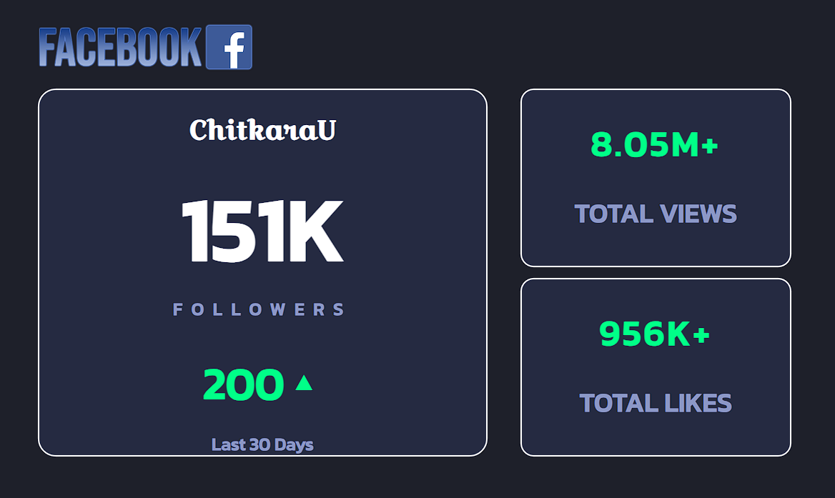
Facebook

Slide 23
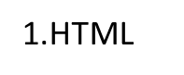
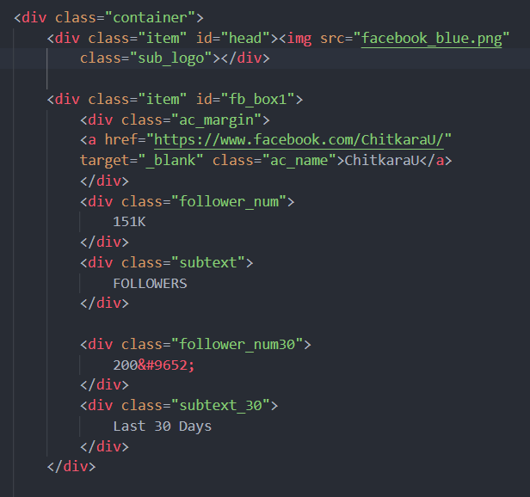
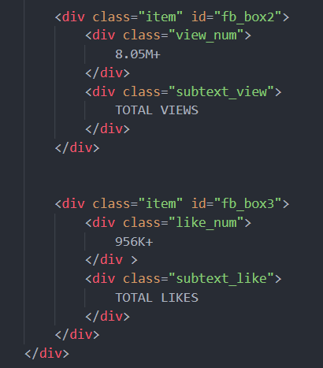
Code

Slide 24
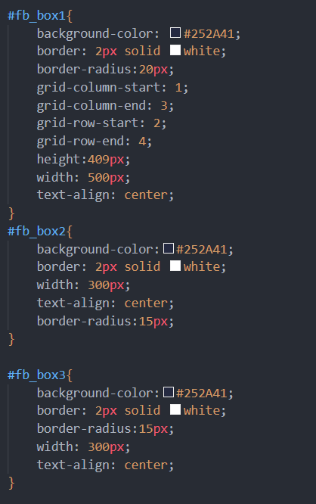
2. CSS

Slide 25
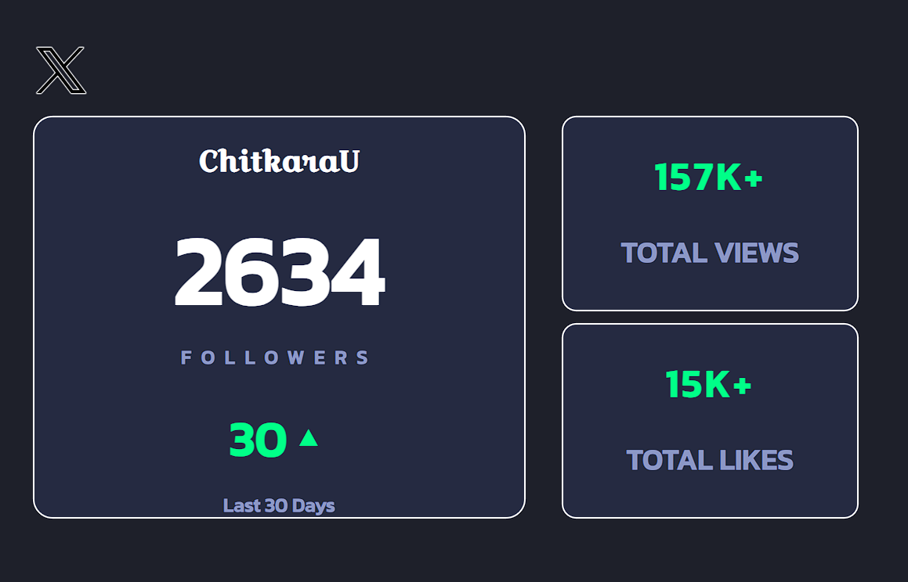
Twitter

Slide 26
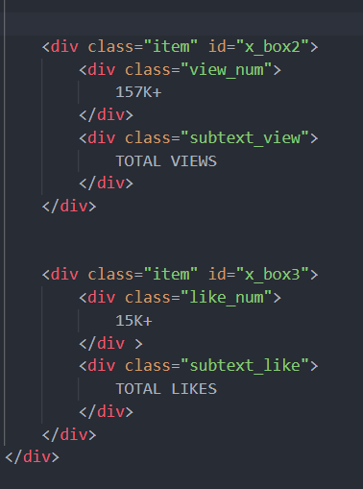
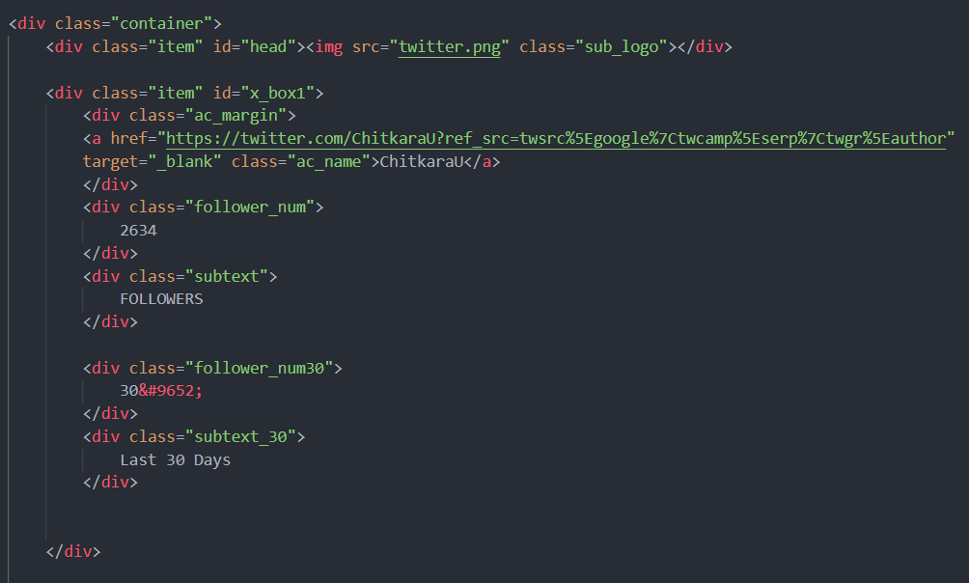
Code

Slide 27
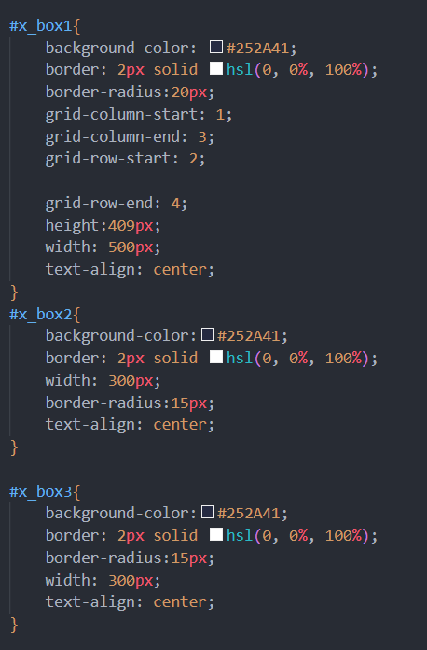
2. CSS

Slide 28
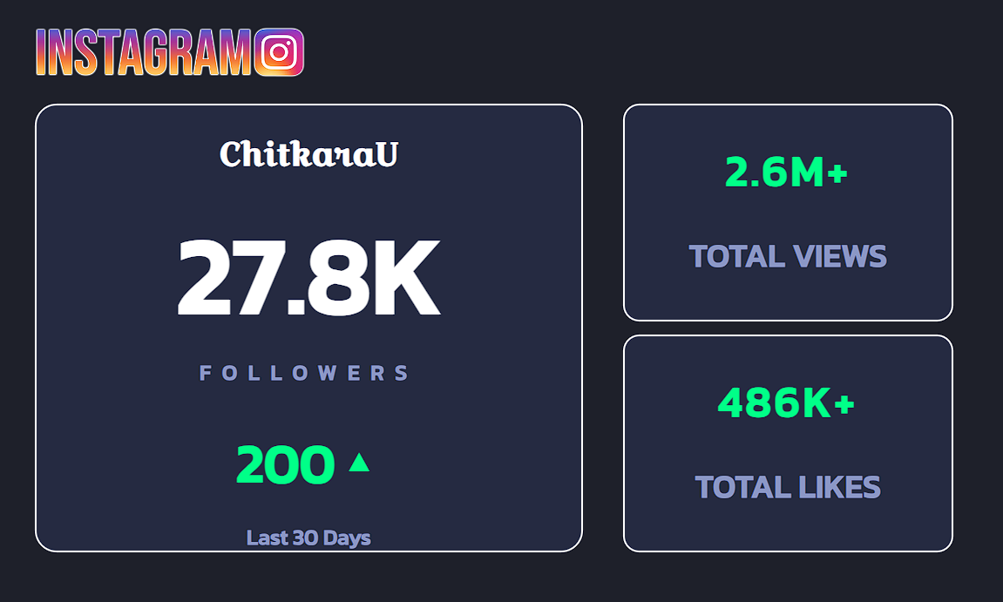
Instagram

Slide 29
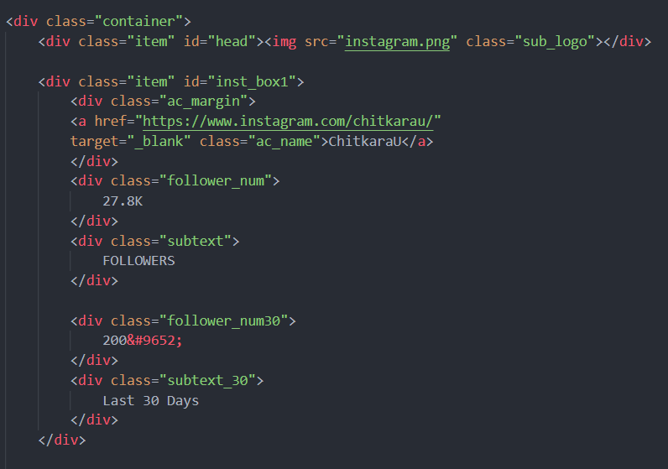
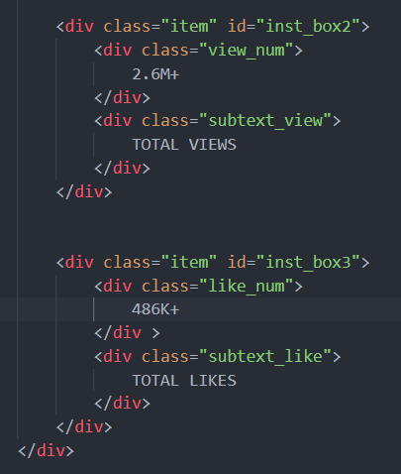
Code

Slide 30
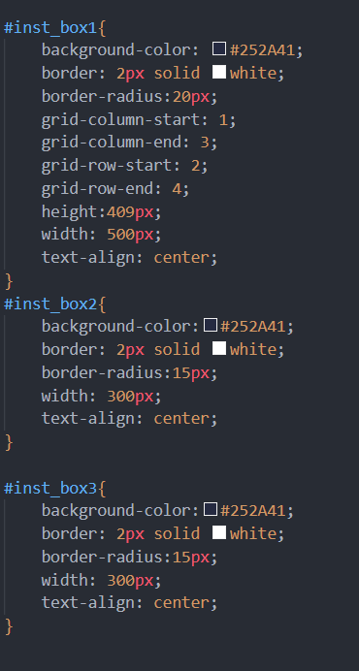
2. CSS

Slide 31
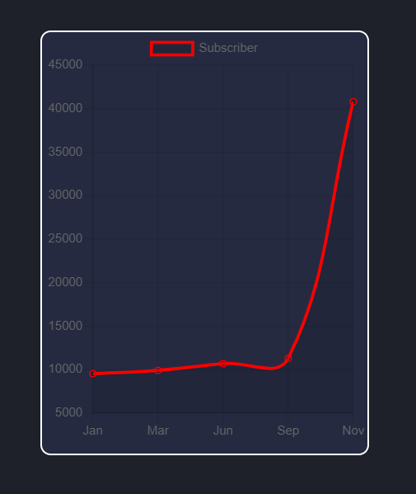
Charts

Slide 32
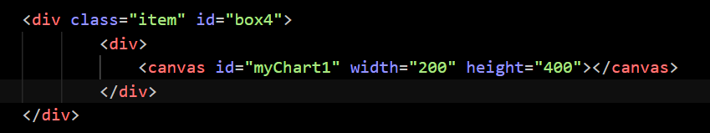
Codes
1. HTML

Slide 33
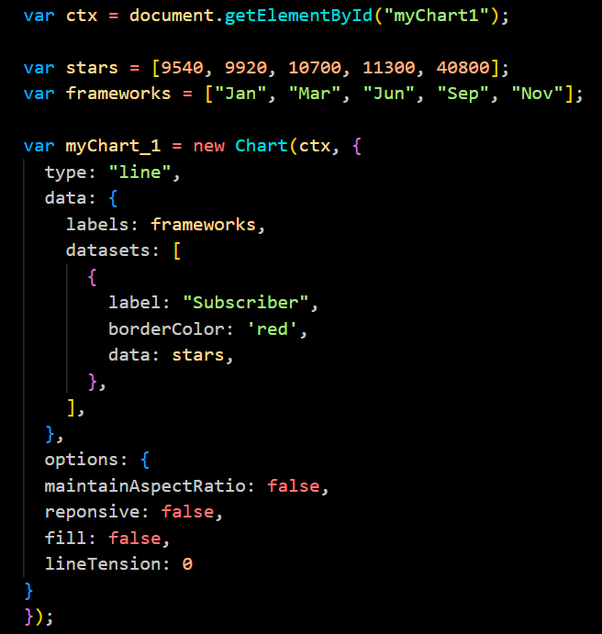
2. Javascript

Slide 34


Conclusion
While developing the system a conscious effort has been made to create and develop a software package, making use of available tools, techniques and resources – that would generate a proper system for working of SOCIAL DASHBOARD.
We understand the immense potential of a social media analytics dashboard is vital for effective strategizing, planning, and monitoring of your social media efforts choosing the right dashboard can make all differences. A dashboard with a clear and straightforward style can help improve the platform’s accessibility for users with disabilities, such as visual impairments. We have tried to assist you in navigating the platform more swiftly and efficiently, completing tasks.
While making the system, an eye has been kept on making it as user-friendly. As such one may hope that the system will be acceptable to any user and will adequately meet his/her needs. It is a powerful tool that harnesses the capabilities of HTML and CSS to provide user with analysis of any socially networking website. By following proper testing and debugging procedures, we can ensure that this dashboard functions smoothly and delivers accurate results.

Slide 35

References/Links used
List of all the links and references used in this in this project :
https://bulk.ly/social-media-dashboard/
https://slidesgpt.com/
https://youtu.be/dxNc5zNxYXE?si=CrU7lpiyHbT9_QG9
https://bulk.ly/social-media-dashboard/

Slide 36


